Slide 1

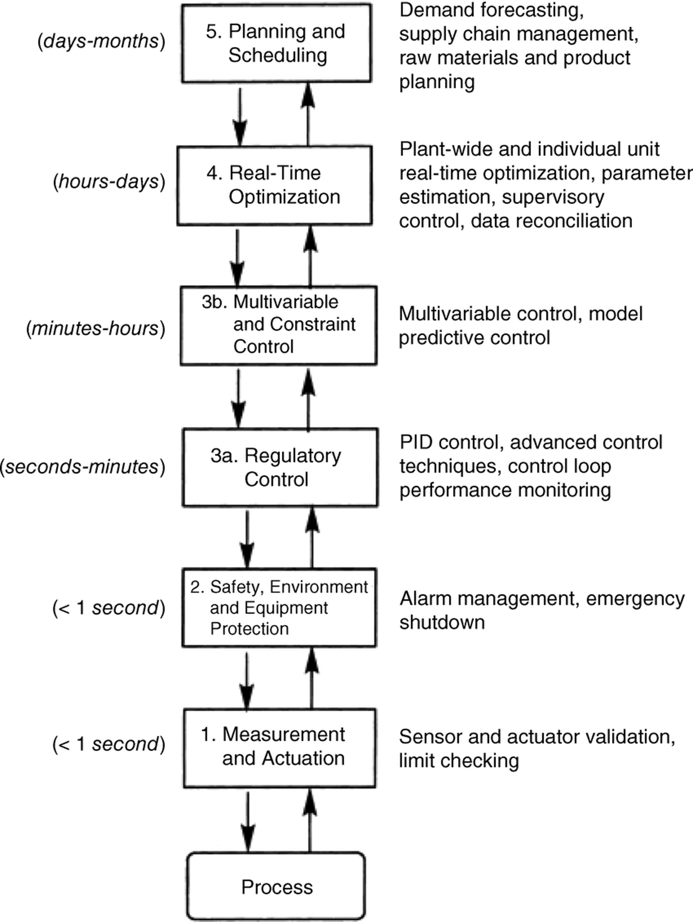
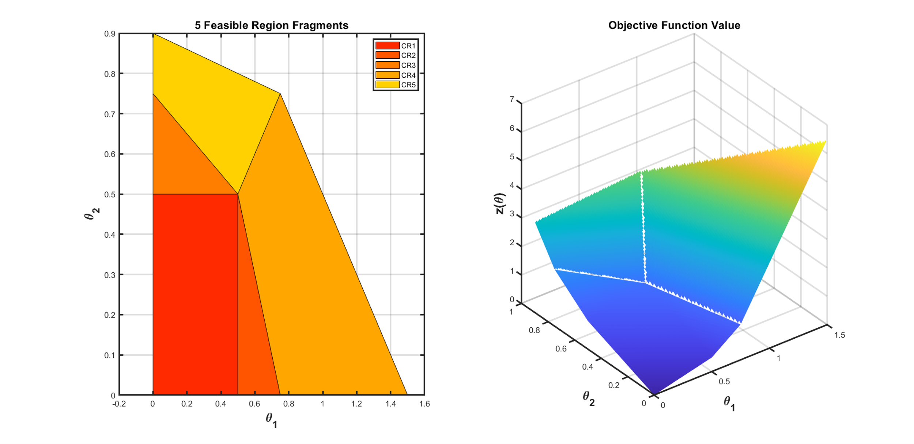
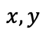
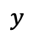
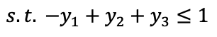
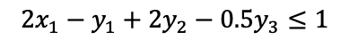
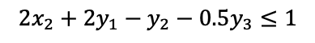
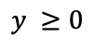
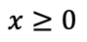
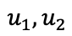
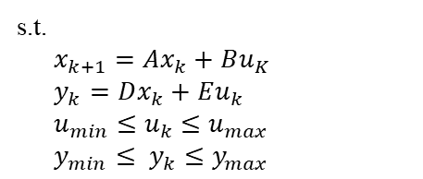
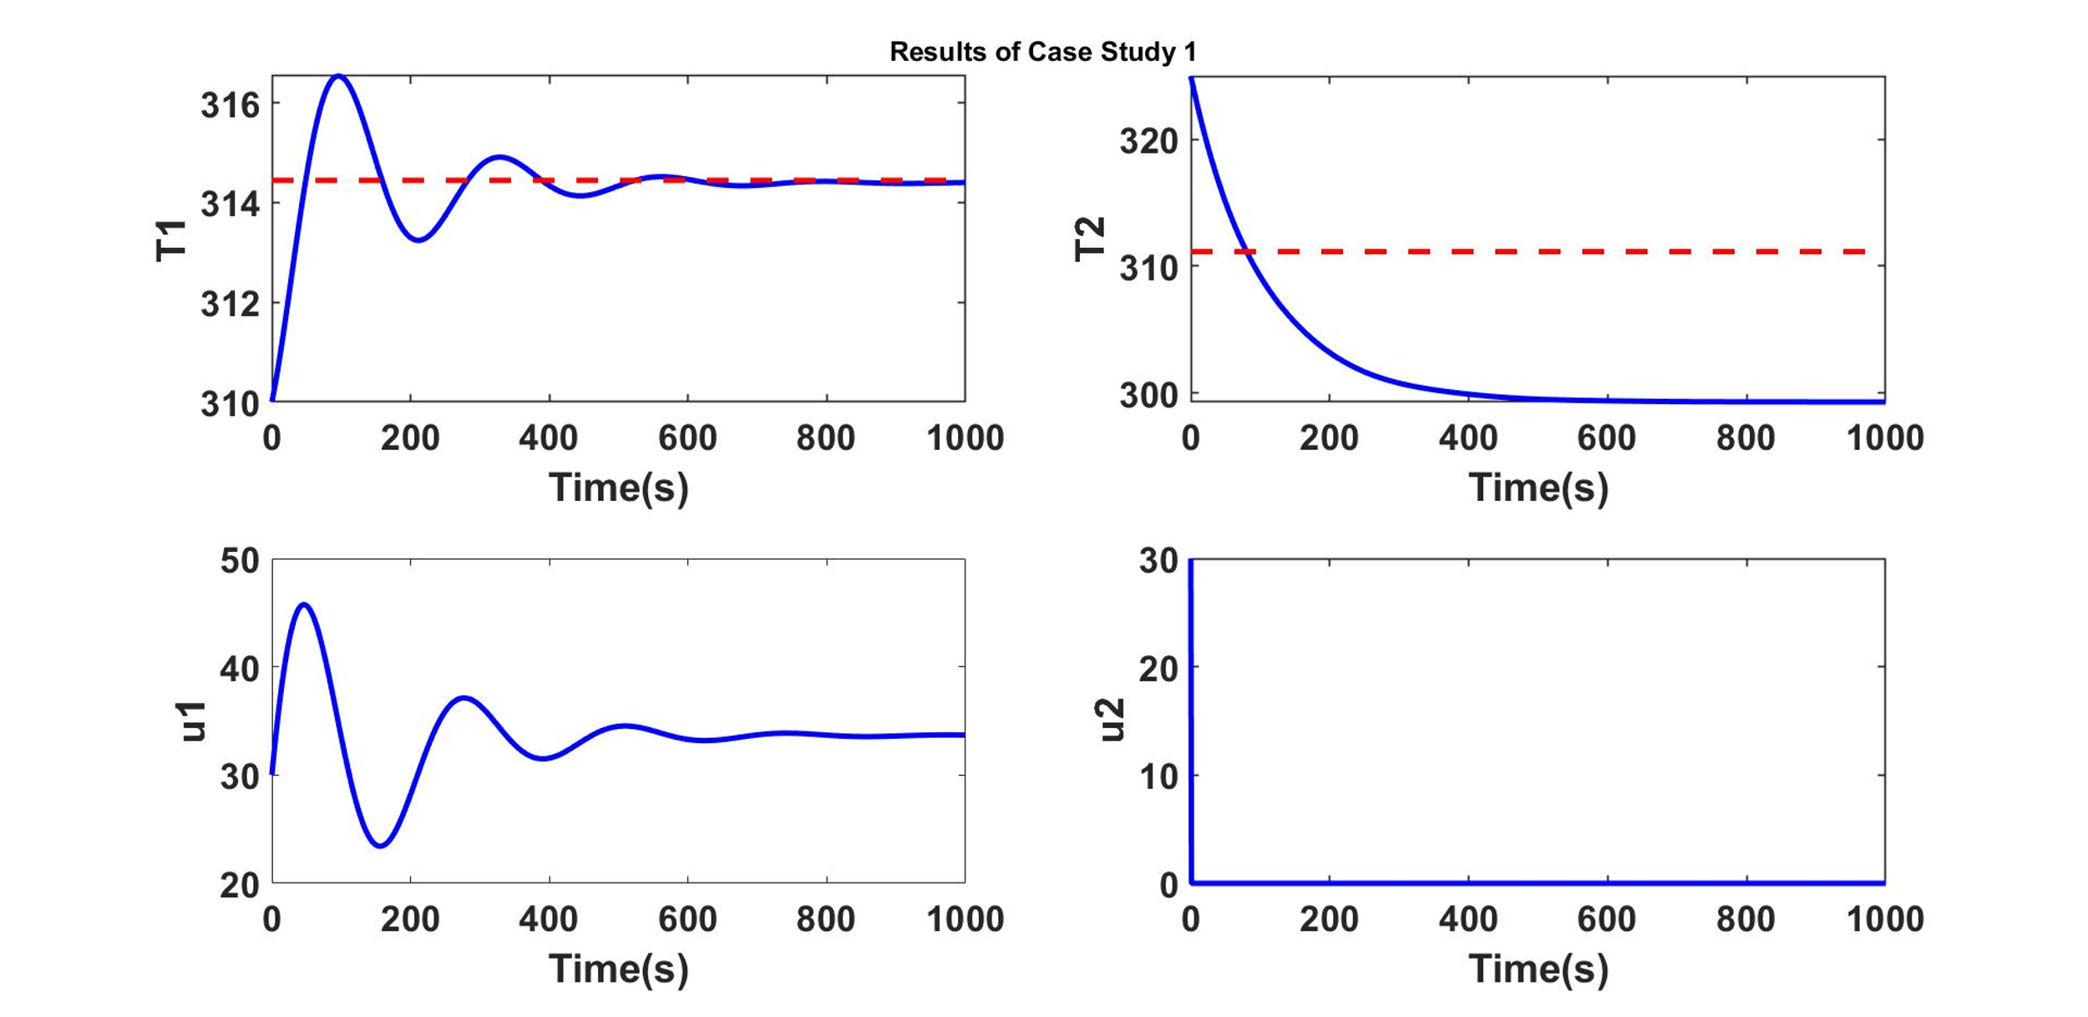
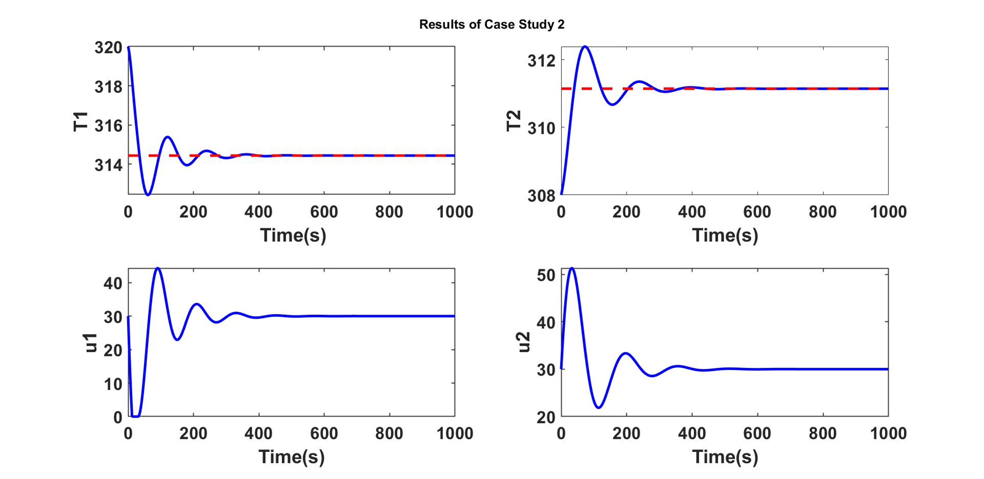

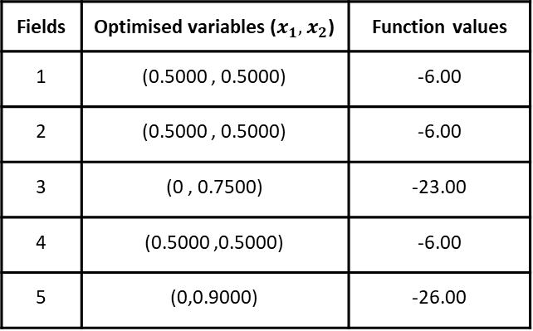
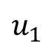
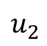
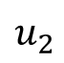
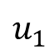
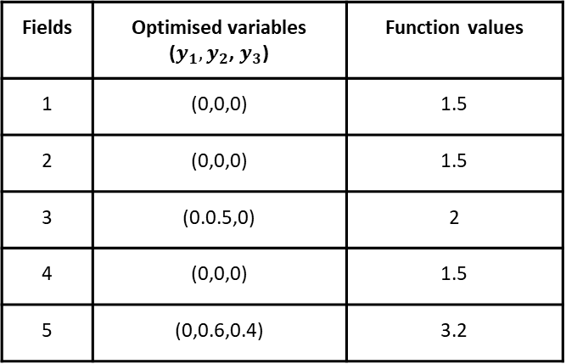
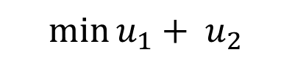
Application Of
Bilevel Programming To
Model Predictive Control
Subhi Gupta and Hari S. Ganesh
Discipline of Chemical Engineering,
Indian Institute of Technology Gandhinagar.
Background
Multilevel Structure
Important Terminologies
Hierarchy is characterized by vertical decomposition, priority of action, and performance interdependence.
Bidirectional communication exists between levels in any hierarchical large-scale system.
Figure 1 shows the five levels in the process control hierarchy.
Figure 2 represents the simplest hierarchical system.
Bilevel MPC Control Structure
Upper-level subsystem
Controller 1 (Optimisation Problem 1)
Decision connections
Information
connections
Lower-level subsystem
Controller 1 (Optimisation Problem 1)
Motivation
Figure 1: Process Control Hierarchy
Figure 2: Bilevel decision-making structure
Sparse attempts have been made to solve hierarchical control problems.
Multi-parametric bi-level programming algorithm have been used in the proposed work to solve bilevel multi-parametric/explicit MPC controller (Bilevel mp-MPC).
Use of a multi-parametric programming approach guarantees a global optimal solution for multilevel programming problems.
Multi-parametric Bilevel Programming Algorithm
Inner Level solved multi-parametrically
Methodology
Fields | Optimised variables ($x_{1},x_{2}$) | Function values
1 | (0.5000 , 0.5000) | -6.00
2 | (0.5000 , 0.5000) | -6.00
3 | (0 , 0.7500) | -23.00
4 | (0.5000 ,0.5000) | -6.00
5 | (0,0.9000) | -26.00
Fields | Optimised variables ($y_{1},y_{2}$, $y_{3}$) | Function values
1 | (0,0,0) | 1.5
2 | (0,0,0) | 1.5
3 | (0.0.5,0) | 2
4 | (0,0,0) | 1.5
5 | (0,0.6,0.4) | 3.2
Five critical regions are obtained with y as an explicit function of x.
System considered: Temperature Control Laboratory (TCLab)
Steps Taken:
Modeling of the system.
Model equations reduced to linear state-space equations.
MPC and mp-MPC algorithms implemented on the system.
Run-time operation compared (Table 1).
Billevel MPC control structures designed.
Solved using multi-parametric bi-level programming algorithm.
Closed loop validation performed.
Results (Figure 6 and 7) show that designed controllers manage
to follow the temperature set-point.
The solution obtained after solving five LP outer level problem
Substitution of optimized variables to get solutions to inner-level problems.
Global optimum solution
Linear Model Predictive Control on TCLab
$$\min{Σ {\left(y_{k}− y_{k}^{R}\right)}^{T} Q_{k}\left(y_{k}− y_{k}^{R}\right)+Σ{\left(u_{k}−u_{k}^{R}\right)}^{T}R_{k}\left(u_{k}−u_{k}^{R}\right)+ ΣΔu_{k}^{T}{R1}_{k}(Δu_{k})}$$
Objective function
System Model
Constraints
Results
Comparison based on runtime operation.
No. | Type of MPC | Total runtime (s)
1 | Online MPC | 5.351
2 | mp-MPC | 0.912
Runtime operation reduced by 83.52%.
Table 1
Bilevel MPC Control Structures
$$\min{u_{1}+ u_{2}}$$
${min (T_{1}− T_{1}^{R})}^{T}Q_{1}(T_{1}−$ $T_{1}^{R}$) + ${(u_{1}− u_{1}^{R})}^{T}R_{1}(u_{1}−$ $u_{1}^{R}$) + $Δu_{1}^{T}{R1}_{1}Δu_{1}$
$$u_{2}$$
$$u_{1}$$
${min (T_{1}− T_{1}^{R})}^{T}Q_{1}(T_{1}−$ $T_{1}^{R}$) +${(u_{1}− u_{1}^{R})}^{T}R_{1}(u_{1}−$ $u_{1}^{R}$) + $Δu_{1}^{T}{R1}_{1}Δu_{1}$
${min (T_{2}− T_{2}^{R})}^{T}Q_{2}(T_{2}−$ $T_{2}^{R}$) +${ (u_{2}− u_{2}^{R})}^{T}R_{2}(u_{2}−$ $u_{2}^{R}$) + $Δu_{2}^{T}{R1}_{2}Δu_{2}$
$$u_{1}$$
$$u_{2}$$
Conclusion
The proposed work presented multi-parametric bilevel programming framework under uncertainty.

